Slide 1


Quantum-Inspired IR/Language Modelling
Qiuchi Li, Benyou Wang
University of Padua
Toutiao, Beijing, China, 28/06/2019
Notes:
Good Afternoon. My name is Qiuchi LI, and I am a second-year PhD from University of Padua. It is my great honor to present this work. It is a joint work with my colleague Benyou Wang, and Supervisor Massimo Melucci, and Benyou and I contribute equally to this work. This work is funded by the QUARTZ European Union Marie Curie Research Project, and all three authors are in this project.
Basically what we do is to build a neural network for text matching, but it is different from classical one in that the network components can be explained as concepts in quantum physics with well-constrained complex-valued representation.

Slide 2

Relationship with Quantum Computing
Quantum Physics
Quantum Computing
Quantum inspired/motivated ML
Mathematical formulation

Slide 3
Relationship with Quantum Machine Learning
Classical Machine learning from Quantum, e.g. Boltzmann machine, Gradient decent
Machine Learning deployed on Quantum computers, speed up the classical machine learning algorithms

Slide 4
Quantum theory Outside Physics
Social science
[E. Haven and A. Khrennikov. 2013. Quantum Social Science. Cambridge University Press.]
Cognition science
[Jerome R. Busemeyer and Peter D. Bruza. 2013. Quantum Models of Cognition and Decision. Cambridge University Press]
Information retrieval
[Alessandro Sordoni, Jian-Yun Nie, and Yoshua Bengio. 2013. Modeling term dependencies with quantum language models for IR. In Proc. of SIGIR. ACM, 653–662.]
Quantum mind/brain/consciousness/cognition
Our works do not rely on quantum cognition

Slide 5
Contents
History of quantum-inspired IR/NLP
Basics from Quantum Theory
Semantic Hilbert Space—NAACL best paper
Future work with Quantum Theory

Slide 6
Main Researchers
Massimo Melucci, University of Padova
Peng Zhang/Yuexian Hou,Tianjin University
Dawei Song, BIT
Christina Lioma, University of Copenhagen
Peter Bruza, Queensland University of Technology
Van Rijsbergen
Diedarik Aerts and Andrei Khrennikov
Bruseymer, University of Indiana
Jian-yun Nie, University of Montreal
Nadav Cohen, University of Princeton
Lei Wang, Institute of Physics, Chinese academy of science

Slide 7

Quantum IR
Quantum Formulism can formulate the different IR models (logic, vector, probabilistic, etc.) in a unified framework.
C.J. van Rijsbergen
UK Royal Academy of Engineering Fellow
SIGIR 2006 Salton Award Lecture
[C.J. van Rijsbergen 2004, Geometry of Information Retreival]
[Piwowarski B, et al. What can quantum theory bring to information retrieval. CIKM 2010. 59–68]

Slide 8
Roadmap of Quantum IR formal models
Milestones
Quantum Analogy based IR Methods
Double Slit (Zuccon et al. ECIR 2009) Photon Polarization (Zhang, et al. ECIR 2011, ICTIR 2011)
Pros & Cons: + Novel intuitions [ECIR’11 Best Poster Award] - Shallow analogy - Inconsistent with quantum axioms
Quantum Language Models (QLMs)
Original QLM (Sordoni et al. SIGIR 2013) QLM variants (Li, Li, Zhang, SIGIR 2015) (Xie, Hou*, Zhang*, IJCAI 2015)
Pros & Cons: + Consistent with axioms - QLM components are designed separately, instead of learned jointly
Neural Quantum Language Models
End2end QLM for QA (Zhang et al. AAAI 2018) Further variants (Zhang et al. Science China 2018)
Pros & Cons: + Effective joint learning for Question answering; - Lacks inherent connection between NN and QLM - Cannot model complex interaction among words
Credits from Prof. Peng Zhang

Slide 9
Quantum Theory & NN
Neural Network
[1,2]
Quantum Mechanics
[3,4]
[1] Carleo G, Troyer M. Solving the quantum many-body problem with artificial neural networks[J]. Science, 2017, 355(6325): 602-606.
[2] Gao X, Duan L M. Efficient representation of quantum many-body states with deep neural networks[J]. Nature communications, 2017, 8(1): 662.
[3] Lin X, Rivenson Y, Yardimci N T, et al. All-optical machine learning using diffractive deep neural networks[J]. Science, 2018, 361(6406): 1004-1008.
[4] Levine Y, Yakira D, Cohen N, et al. Deep Learning and Quantum Entanglement: Fundamental Connections with Implications to Network Design[C]. ICLR 2018.
Notes:
改！！！

Slide 10
Contents
History of quantum inspired IR/NLP
Basics from Quantum Theory
Semantic Hilbert Space—NAACL best paper
Future work with Quantum Theory

Slide 11
Basic Dirac notations
Bra & Ket
Bra: like a row vector, e.g.
Ket: like a column vector, e.g.,
Inner Product
Outer Product
$$<⋅|$$
$$<x|$$
$$|⋅>$$
$$|x>$$
$$<x|x>$$
$$|x><x|$$

Slide 12
Four axioms in Quantum Mechanics
Axiom 1: State and Superposition
Axiom 2: Measurements
Axiom 3: Composite system
Axiom 4: Unitary Evolution
[Nielsen M A, Chuang I L. 2000]

Slide 13
Quantum Preliminaries
Hilbert Space
$$H$$

Slide 14
Quantum Preliminaries
Hilbert Space
Pure State
Basis State
$$|e_{2}〉$$
$$H$$
$$|e_{1}〉$$

Slide 15
Quantum Preliminaries
Hilbert Space
Pure State
Basis State
Superposition State
$$|e_{2}〉$$
$$H$$
$$|u〉$$
$$|e_{1}〉$$

Slide 16
Quantum Preliminaries
+
Hilbert Space
Pure State
Basis State
Superposition State
Mixed State
$$|e_{2}〉$$
$$H$$
$$ρ$$
$$|e_{1}〉$$

Slide 17
Quantum Preliminaries
Hilbert Space
Pure State
Basis State
Superposition State
Mixed State
Measurement
$$|e_{2}〉$$
$$H$$
$$|v_{1}〉$$
$$ρ$$
$$p_{1}$$
$$|e_{1}〉$$
$$p_{2}$$
$$|v_{2}〉$$

Slide 18
Contents
History of quantum inspired IR/NLP
Basics from Quantum theory
Semantic Hilbert Space—NAACL best paper
Future work with Quantum Theory

Slide 19
Research Problem
Interpretability issue for NN-based NLP models
Transparency: explainable component in the design phase
Post-hoc Explainability: why the model works after execution
The Mythos of Model Interpretability, Zachery C. Lipton, 2016
Research questions :
What is the concrete meaning of a single neutron? And how does it work? (probability)
What did we learning after training? (unifying all the subcomponents in a single space and therefore they can mutually interpret each other)
Notes:
Neural Networks have brought about significant breakthroughs in the NLP domain, but one of the most crucial issues facing these neural network-based models is the interpretability issue. In a recent survey by Lipton , the two main properties of model interpretability are transparency and post-hoc explainability, where transparency means we are able to understand how the model works in the design phase, and the components can be explained as concrete concepts, and post-hoc explainability means we can provide reasons of why the model works after it has been deployed to a real task, which involves visualizing the components or giving concrete examples to explain why it is the case in a post-hoc manner. What we attempt to do in this work is to address the interpretability issue for NLP, build a model that is sort of transparent and post-hoc explainable at the same time.

Slide 20
Inspiration
Distributed representation
Understanding a single neutron
How it works
What it learned

Slide 21
How to understand distributed representation (word vector)?

Slide 22


Distributed representation vs Superposition state over sememes
Apple
?
|Apple> = a | > + b | > + … c |?>

Slide 23
Decomposing word vector
Amplitude vector (unit-length vector)
Corresponding weight for each sememe
Phase vector (each element ranges [0,2Pi])
Higher-lever semantic aspect
Norm
Explicit weight for each word.

Slide 24
How to understand the value of a single neutron?

Slide 25
One neutron or a group of neutrons?
Vanilla neutrons
Capsules by Hinton

Slide 26
How does the neural network work?

Slide 27
Driven by probability?
Classical probability: set-based probability theory
(countable) events are in a discrete space
Quantum probability: projective geometry based theory
(uncountable) events are in a continuous space

Slide 28







Uncertainty in Language/QT
A single word may have multiple meanings
Uncertainty of a pure state
“Apple”
Multiple words may be combined in different ways
Uncertainty of a mixed state
“Ivory tower”
+
or

Slide 29
What did it learn?

Slide 30
How to interpret trainable components?
A unified quantum view of different levels of linguistic units
Sememes
Words
Word Combinations
Sentences
Therefore they can mutually interpret each other
Measurement
Word
Sememe
Word combination

Slide 31

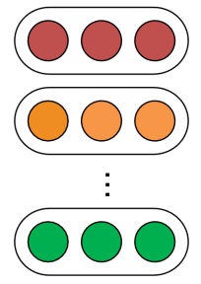
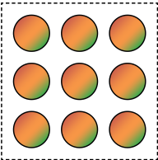

Semantic Hilbert Space
Word
Vectors
Word Semantic Composition
High-level Semantic Features
Words
…
$$\{|w_{i}〉\}$$
$$ρ$$
$$|v_{1}〉$$
$$|v_{2}〉$$
…
$$|v_{k}〉$$
…
…
Pure States
Mixed State
Semantic Measurements
Benyou Wang*, Qiuchi Li*, Massimo Melucci, and Dawei Song. Semantic Hilbert Space for Text Representation Learning. In WWW2019

Slide 32
Application to Text Matching
$$ρ_{q}$$
Mixture
Question:
How did women’s role change during the war ?
Answer:
the World Wars started a new era for women’s opportunities to…
$$|v_{1}〉$$
$$|v_{2}〉$$
Measurement
Mixture

Slide 33
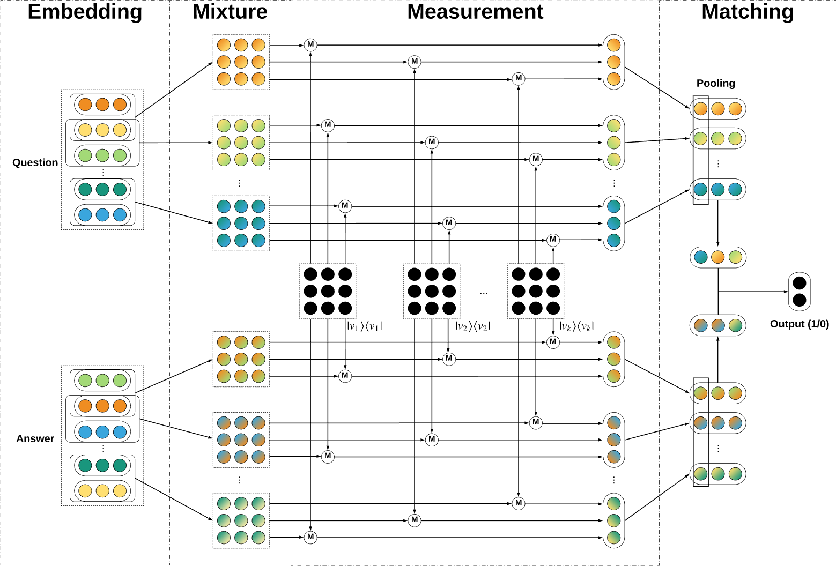
Complex-valued Network for Matching

Slide 34
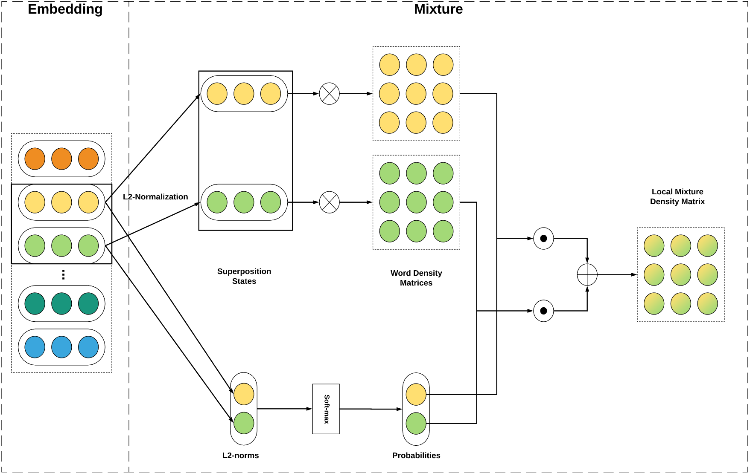
Local Mixture
L2-normed word vectors as superposition states
Softmax-normalized word L2-norms as mixture weights

Slide 35
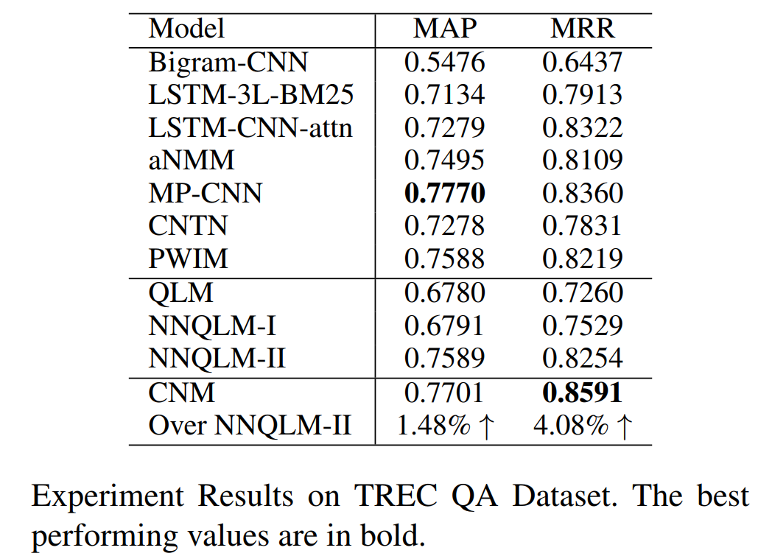
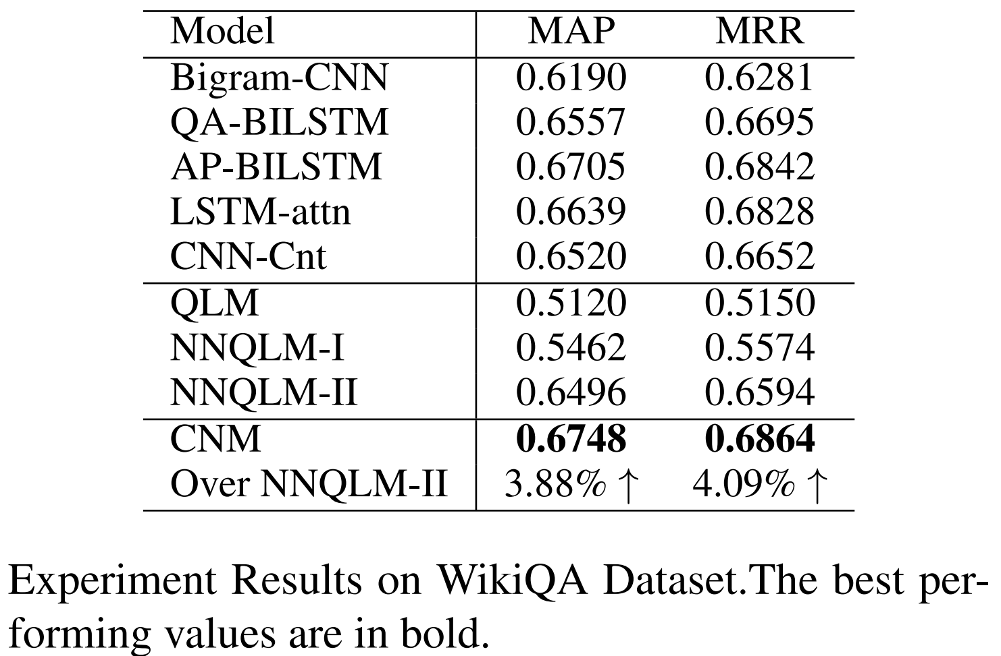
Experiment Result
Effectiveness
Competitive compared to strong baselines
Outperforms existing quantum-inspired QA model (Zhang et al. 2018)

Slide 36
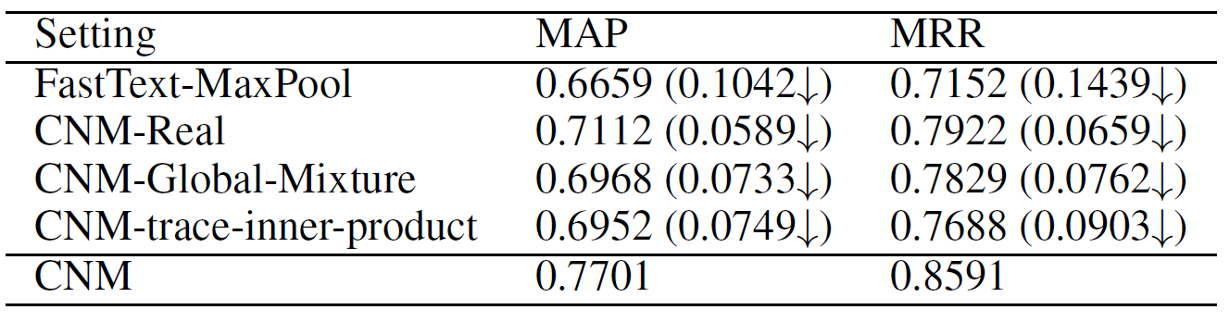
Experiment Result
Ablation Test
Complex-valued Embedding
non-linear combination of amplitudes and phases
Local Mixture Strategy
Trainable Measurement

Slide 37
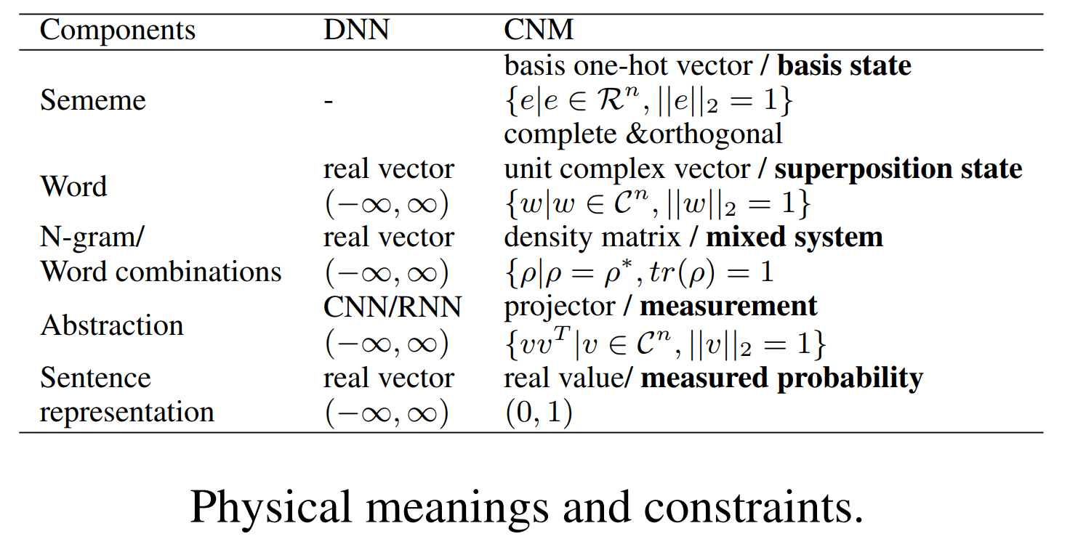
Transparency
With well-constraint complex values, CNM components can be explained as concrete quantum states at design phase

Slide 38
Post-hoc Explainability
Visualisation of word weights and matching patterns
Q: Who is the [president or chief executive of Amtrak] ?
A: ...said George Warrington, [Amtrak ’s president and chief executive].
Q: How did [women ’s role change during the war] ?
A: the [World Wars started a new era for women ’s] opportunities to…

Slide 39
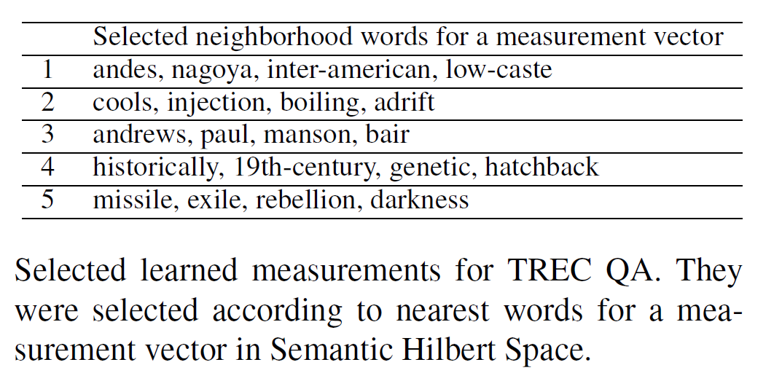
Semantic Measurements
Each measurement is a pure state
Understand measurement via neighboring words

Slide 40
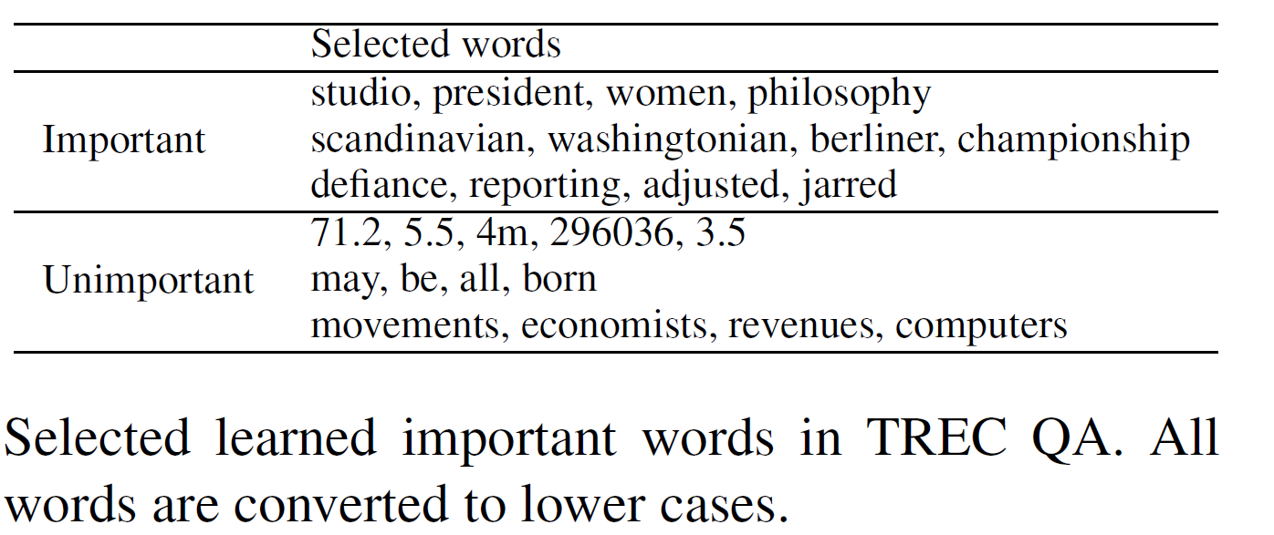
Word L2-norms
Rank words by l2-norms and select most important and unimportant words

Slide 41
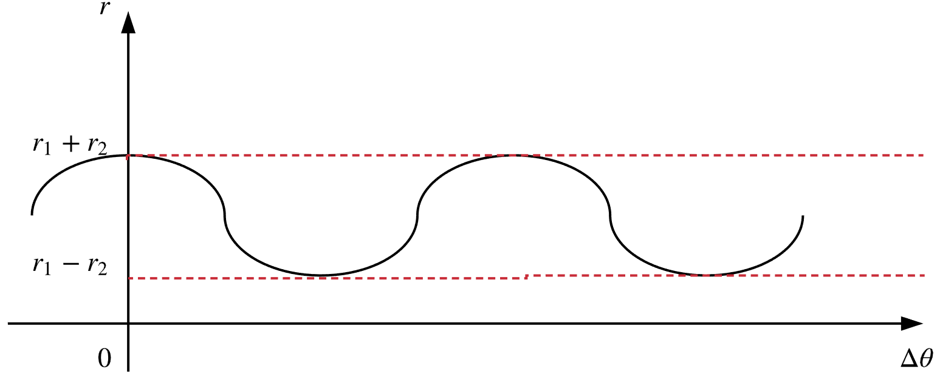
Complex-valued Embedding
Non-linearity
Gated Addition
Ivory tower ≠ Ivory + tower

Slide 42
Other Potentials
Interpretability
Robustnees
orthogonal projection subspaces (measurements)
Transferness
Selecting some measurements is a kind of sampling. More measurements, in principle, lead to more accurate inference with respect to the given input. (like ensemble strategy)
Reusing the trained measurement from one dataset to another dataset makes sense, especially that recent works tends to use a given pertained language model to build the input features

Slide 43
Conclusion & Future Work
Conclusion
Interpretability for language understanding
Quantum-inspired complex-valued network for matching
Transparent & Post-hoc Explainable
Comparable to strong baselines
Future Work
Incorporation of state-of-the-art neural networks
Experiment on larger datasets

Slide 44
Contacts
qiuchili@dei.unipd.it
wang@dei.unipd.it
Source Code
github.com/wabyking/qnn

Slide 45
Contents
History of quantum inspired IR/NLP
Basics from Quantum theory
Semantic Hilbert Space—NAACL best paper
Future work with Quantum Theory

Slide 46
What the companies care
How to improve SOTA
Performance
Efficiency
Interpretability

Slide 47
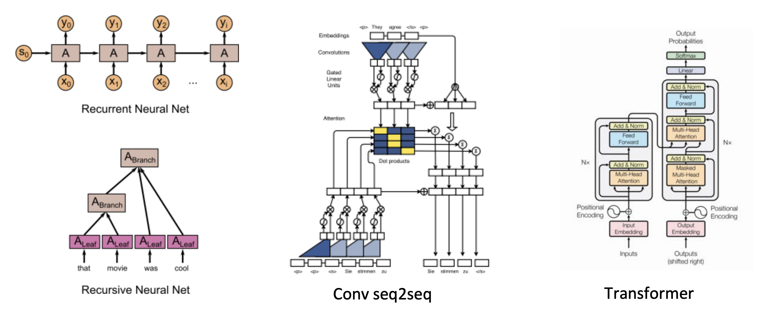
Position and order
Transformer without position embedding is position-insensitive

Slide 48
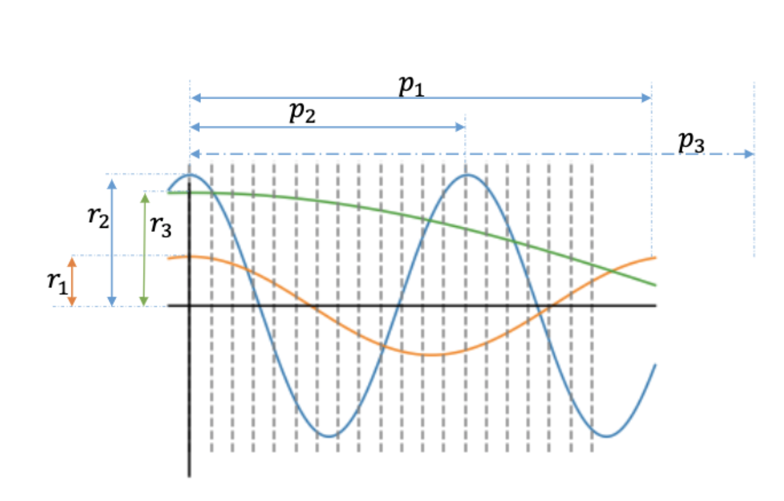
Encoding order
in complex-valued embedding

Slide 49
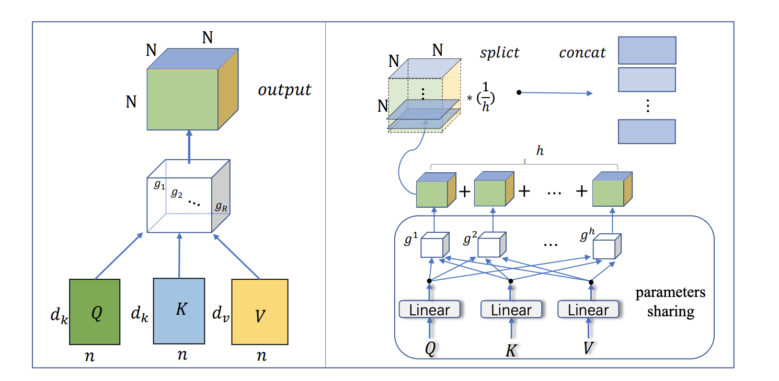
Efficiency
Tensor decomposition
Ma et.al. A Tensorized Transformer for Language Modeling, https://arxiv.org/pdf/1906.09777.pdf

Slide 50
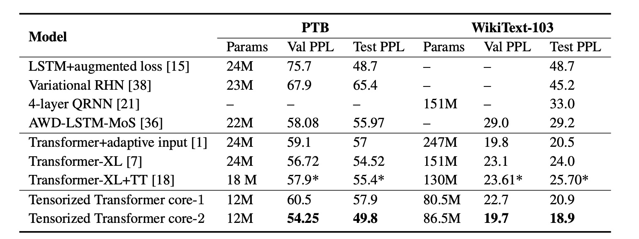
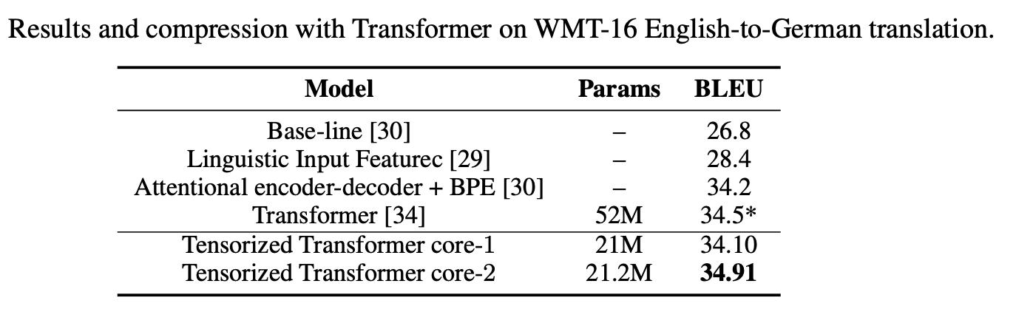
Efficiency
Results in language model
Ma et.al. A Tensorized Transformer for Language Modeling, https://arxiv.org/pdf/1906.09777.pdf

Slide 51
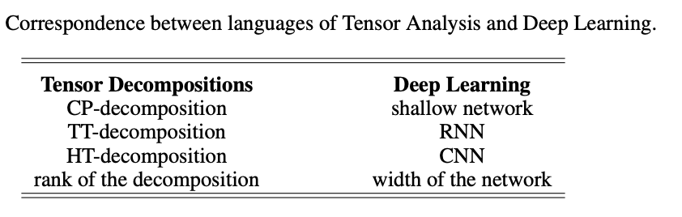
Interpretability
with the connection between tensor and NN
Khrulkov, Valentin, Alexander Novikov, and Ivan Oseledets. "Expressive power of recurrent neural networks." arXiv preprint arXiv:1711.00811 (2017). ICLR 2018

Slide 52
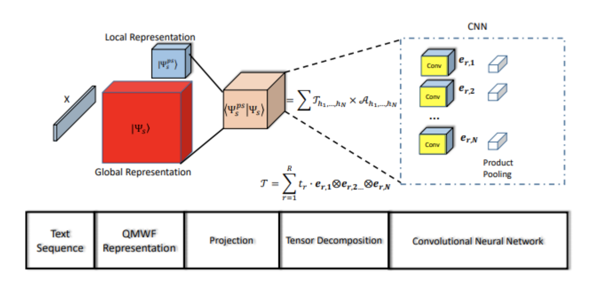
Interpretability (1):
Tensor Vs DL
Zhang P, Su Z, Zhang L, Wang B, Song D. A quantum many-body wave function inspired language modeling approach. In Proceedings of the 27th ACM CIKM 2018 Oct 17 (pp. 1303-1312). ACM.

Slide 53
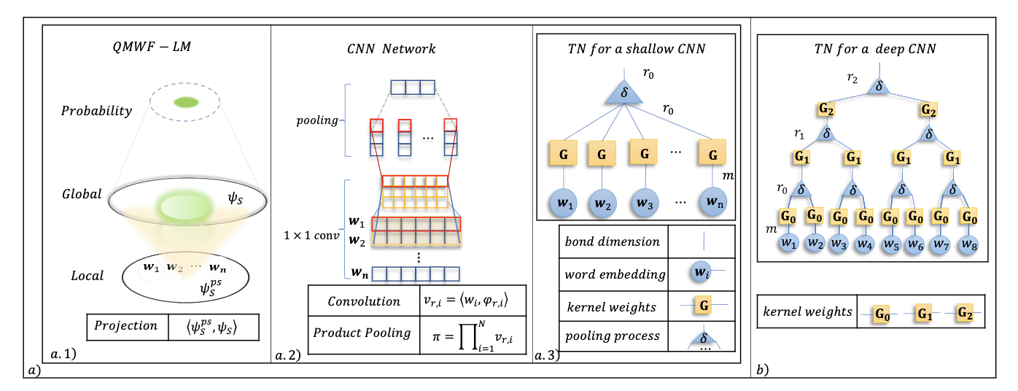
Interpretability (2):
Long-term and short-term dependency

Slide 54
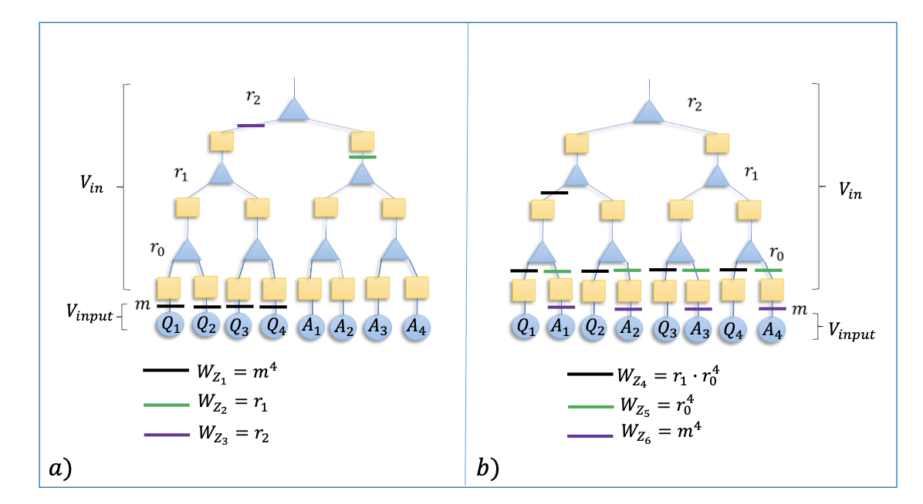
Interpretability (2):
Long-term and short-term dependency

Slide 55
References
Li, Qiuchi, Sagar Uprety, Benyou Wang, and Dawei Song. “Quantum-Inspired Complex Word Embedding.” Proceedings of The Third Workshop on Representation Learning for NLP, 2018, 50–57.
Wang, Benyou, Qiuchi Li, Massimo Melucci, and Dawei Song. “Semantic Hilbert Space for Text Representation Learning.” In The World Wide Web Conference, 3293–3299. WWW ’19. New York, NY, USA: ACM, 2019.
Lipton, Zachary C. “The Mythos of Model Interpretability.” Queue 16, no. 3 (June 2018): 30:31–30:57.
Peter D Bruza, Kirsty Kitto, Douglas McEvoy, and Cathy McEvoy. 2008. “Entangling words and meaning”. pages QI, 118–124. College Publications.
Bruza, P.D., and R.J. Cole. “Quantum Logic of Semantic Space: An Exploratory Investigation of Context Effects in Practical Reasoning.” In We Will Show Them! Essays in Honour of Dov Gabbay, 1:339–362. London, UK: College Publications, 2005.
Diederik Aerts and Marek Czachor. “Quantum Aspects of Semantic Analysis and Symbolic Artificial Intelligence.” Journal of Physics A: Mathematical and General 37, no. 12 (2004): L123.
Diederik Aerts and L. Gabora. “A Theory of Concepts and Their Combinations: II.: A Hilbert Space Representation.” Kibernetes 34, no. 1 (2004): 192–221.
Diederik Aerts and L. Gabora. “A Theory of Concepts and Their Combinations I: The Structure of the Sets of Contexts and Properties.” Kybernetes 34 (2004): 167–191.
Diederik Aerts and Sandro Sozzo. “Quantum Entanglement in Concept Combinations.” International Journal of Theoretical Physics 53, no. 10 (October 1, 2014): 3587–3603.
Sordoni, Alessandro, Jian-Yun Nie, and Yoshua Bengio. “Modeling Term Dependencies with Quantum Language Models for IR.” In Proceedings of the 36th International ACM SIGIR Conference on Research and Development in Information Retrieval, 653–662. SIGIR ’13. New York, NY, USA: ACM, 2013.

Slide 56
Thanks!

Slide 57
Related Works
Quantum-inspired Information Retrieval (IR) models
Query Relevance Judgement (QPRP, QMR,…)
Quantum Language Model (QLM) and QLM variants
Quantum-inspired NLP models
Quantum-theoretic approach to distributional semantics (Blacoe et al. 2013; Blacoe 2015a; Blacoe 2015b)
NNQLM (Zhang et al. 2018)
Quantum Many-body Wave Function (QMWF) (Zhang et al. 2018)
Tensor Space Language Model (TSLM) (Zhang et al. 2019)
QPDN (Li et al. 2018; Wang et al. 2019)

